Slide 1


EENG385 - Electronic Devices and Circuits
Lab 03:
Ramp Generator
Objective: The objective of this lab is analyze, simulate and assemble the pseudo ramp generator.
1

Slide 2
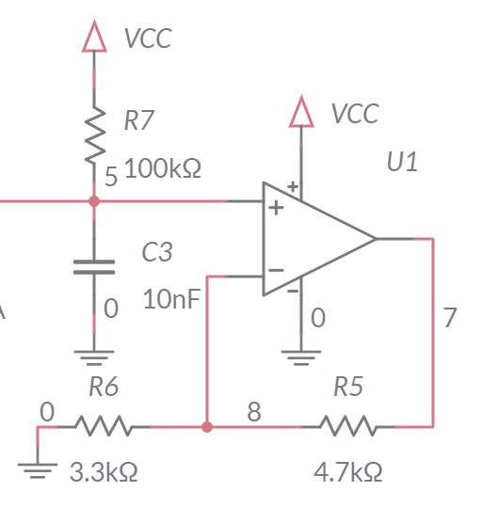
Analyze: Pseudo Ramp Generator
The 10nF capacitor C3 charges towards VCC = 9V
Charges for 270us then reset (by 555 timer)
The charging is close to a straight line
Compare charging cap to a straight line in Excel
2
2
Notes:
2

Slide 3
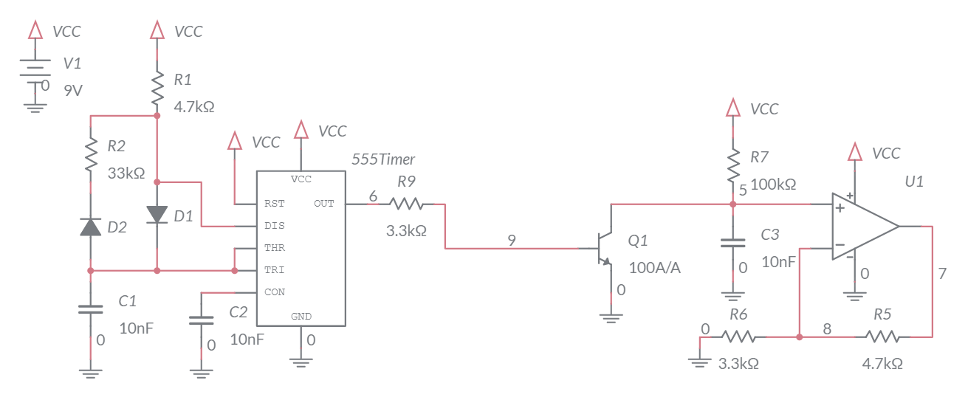
Simulation: Pseudo Ramp Generator
Build in Multisim
Charge on capacitor is cleared by BJT
Simulate to verify calculations
3
3
Notes:
3

Slide 4
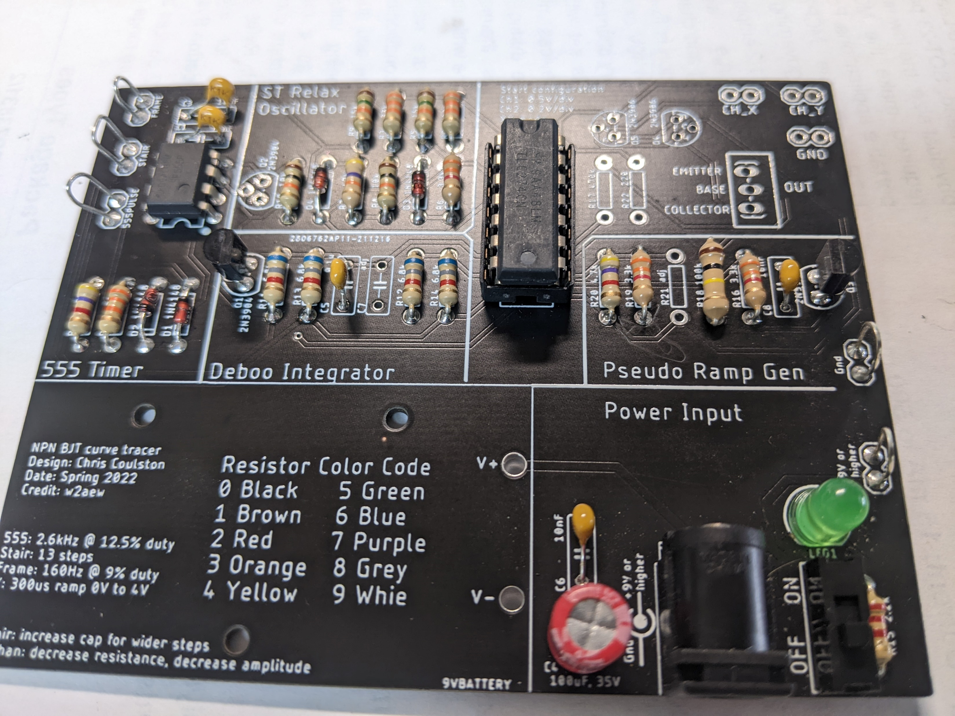
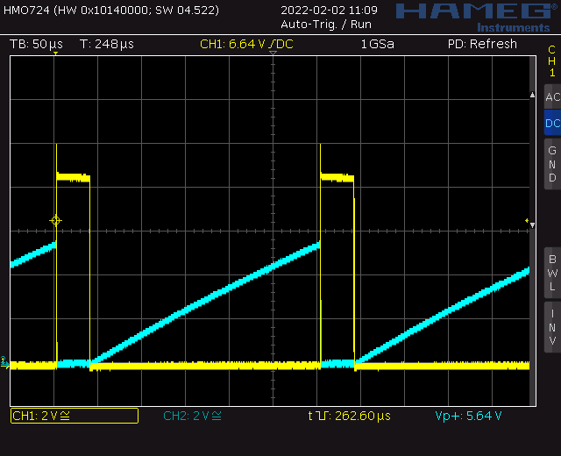
Asemble: Pseudo Ramp Generator
Assemble
Annoying big 100k
2N3904 clears charge off cap
Compare analysis, simulation and actual circuit
4
4
Notes:
4

